Slide 1
30 Outstanding
Hispanics
Life highlights
Contribution
Photo

Slide 2
PAPA FRANCISCO
Name: Jorge Mario Bergoglio
Country: Argentina
Date of Birth: December 17, 1936
What does he do?: He is the leader of the Catholic Church
He is the first Latin American Pope and is best known for being humble and accessible. He breaks the rules when he rejects the luxury items traditionally received by Popes, such as religious clothes and accessories, services, splendorous rooms, and nice cars. Pope Francis stirs religious and political sectors with his daring positions on controversial issues such as abortion, respect for nature, capitalism, immigration, and gay marriage.
Pope Francis identifies with the humble people, and he shows it by living simply and without frills.
Source: https://www.spoots.com/papas-mas-importantes-de-la-historia and https://youtu.be/3p8gfIcQ7sk. Photo: Wikipedia

Slide 3
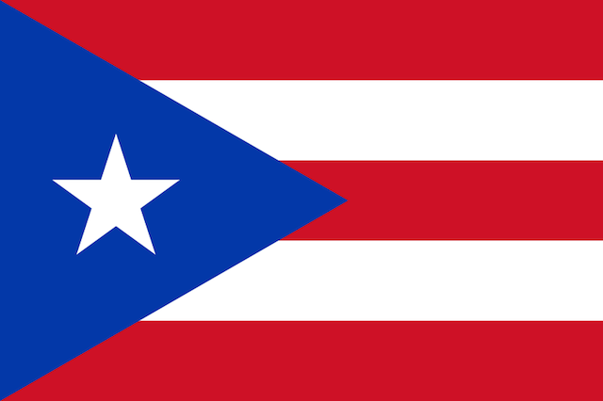
ROBERTO CLEMENTE
Name: Roberto Clemente Walker
Country: Puerto Rico
Date of Birth: August 18, 1934
What does he do?: He is a baseball player
A professional Major League Baseball player from the United States who played for the Pittsburgh Pirates and won many awards during his career. Roberto Clemente was the first Latin American to connect 3,000 hits and enter into the Baseball Hall of Fame. Ready to help Nicaraguans, he died in an airplane crash when taking supplies to Nicaragua after an earthquake.
Roberto Clemente fought against prejudice, defended the image of Latin American players, and promoted sports education for the youth of his country.
Source: https://es.wikipedia.org/wiki/Roberto_Clemente

Slide 4
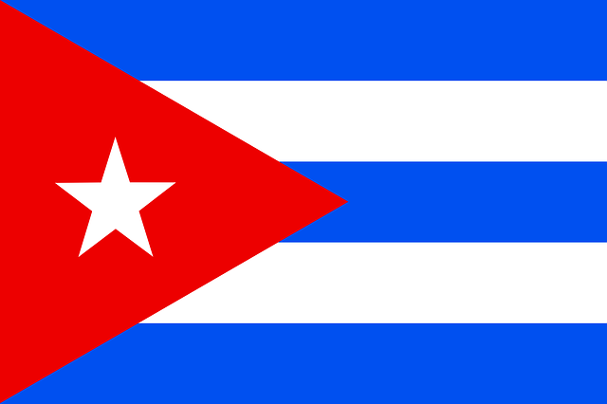
DESI ARNAZ
Name: Desiderio Alberto Arnaz y de Acha III
Country: Cuba
Date of Birth: March 2, 1917
What does he do?: He is an actor and musician
He worked in various professions to help his family. He lived in Miami until he was accepted as a guitarist for the Siboney group. He participated in films and joined the army in World War II. He was responsible for entertaining the troops. He also developed and participated in numerous episodes of the series I love Lucy, the most successful TV show in history. He then retired from show business and moved to Baja California.
He introduced the conga to Miami, and he was a pioneer of television studio filming techniques.
Source: https://www.spoots.com/papas-mas-importantes-de-la-historia and https://youtu.be/3p8gfIcQ7sk. Photo: Wikipedia

Slide 5
ELLEN OCHOA
Name: Ellen Ochoa
Country: United States (Mexican Descent)
Date of Birth: May 10, 1958
What does she do?: She is an astronaut
NASA chose her in January 1990, and she become an astronaut the very next year. She studied optical systems to process information and was the co-inventor of three patents for optical systems. She made her first trip on the space shuttle Discovery in 1993. She made a total of four space flights, and she is currently the director of the Lyndon B. Johnson Space Center.
She is the first Latina in the world to travel to space.
Source: https://es.wikipedia.org/wiki/Ellen_Ochoa

Slide 6
ANTONIA COELLO DE NOVELLO
Name: Antonia Coello de Novello
Country: Puerto Rico
Date of Birth: August 23, 1944
What does she do?: She is a doctor
She began her public health career when she joined the United States Public Health Service Commissioned Corps, a unit of doctors and health professionals working in low-income areas, Indian reservations, and locations where there is a shortage of medical personnel. She now works on AIDS research and fights to raise awareness about AIDS.
She is the first woman and first Hispanic to occupy the position of Surgeon General of the United States.
Source: http://web.mit.edu/21f.712/www/group4/novello.html

Slide 7
JOSEPH ACABA
Name: Joseph Michael "Joe" Acaba
Country: United States (Puerto Rican descent )
Date of Birth: 17 de mayo de 1967
What does he do?: He is an astronaut
He is the first Puerto Rican to be chosen as an astronaut. He serves as a flight engineer aboard the International Space Station. In 2012, Acaba made his second trip into space where he become the first Hispanic who spent the most time outside of Earth.
He was a former middle and high school science and math teacher, and he promotes the study of science and mathematics among young people.
Source: http://www.univision.com/noticias/educacion/astronauta-joe-acaba-sera-el-hispano-que-mas-tiempo-pase-en-el-espacio and https://es.wikipedia.org/wiki/Joseph_Acaba

Slide 8
CELIA CRUZ
Name: Úrsula Hilaria Celia Caridad Cruz Alfonso
Country: Cuba
Date of Birth: October 21, 1925
What does she do?: She is a singer
She is known as “The Queen of Salsa.” She started her career in Cuba when she won a talent contest. She taught literature classes, worked at a Cuban radio station, and sang at the Tropicana Nightclub. Throughout her career, Celia made many tropical rhythms famous, but the genre that made her famous was salsa. She popularized the expression “Azúcar!” which is her legendary catchphrase.
She was one of the most influential female figures in the history of Latin music. After the Cuban revolution, she became a symbol of artistic freedom for Cubans in exile.
Source: https://es.wikipedia.org/wiki/Celia_Cruz and http://web.mit.edu/21f.712/www/group4/celia_cruz.html. Photo: https://celiacruz.com/celia-cruz-the-queen-of-salsa-wins-smithsonians-contest-for-most-iconic-american/

Slide 9
TITO PUENTE
Name: Ernesto Antonio Puente
Country: United States (Puerto Rican Descent)
Date of Birth: April 20, 1923
What does he do?: He is percussionist
He received a strong musical training and started his career in mambo. He became a great musician of this genre and developed a fusion of jazz and rhythm that had a profound influence on the success of salsa. They call him the King of the Timbales for his ability with this instrument. He composed the mambo “Oye cómo va," recorded 198 albums, and even has a star on the Walk of Fame in Hollywood.
He helped to bring African-American and Caribbean rhythms, such as mambo and cha cha cha, to a
mainstream audience.
Sources and Photo: https://www.biografiasyvidas.com/biografia/p/puente_tito.htm and https://es.wikipedia.org/wiki/Tito_Puente

Slide 10
SELENA
Name: Selena Quintanilla Pérez
Country: United States
(Mexican Descent)
Date of Birth: April 16, 1971
What does she do?: She is a singer
She was one of the most important figures of the Latin genre and was a great proponent of Latin music. She is known as the Tex-Mex Queen, and was the most influential and best-selling Latin artist from the 90s. She was also a singer, businesswoman, model, actress, and fashion designer.
She promoted the Tex-Mex genre to popular audiences.
Source: https://es.wikipedia.org/wiki/Selena . Photo: Amazon http://a.co/ikxcadh

Slide 11
CARLOS SANTANA
Name: Carlos Humberto Santana Barragán
Country: México
Date of Birth: July 20, 1947
What does he do?: He is a rock guitar player
He is considered the 20th best guitarist of all time, according to Rolling Stone magazine. He founded the Santana Blues Band and triumphs at the 1969 Woodstock Festival with his fusion of rock and Latin rhythms. He received a Grammy in 1988 for the best instrumental show and the honor of having a star on the Walk of Fame in Hollywood. Today he has a solo career.
Pioneer of fusion of rock and Latin music. Creates the Milagro Foundation to help children and young people in the areas of arts, education and health.
Source: https://www.buscabiografias.com/biografia/verDetalle/4697/Carlos%20Santana and https://es.wikipedia.org/wiki/Carlos_Santana

Slide 12
RITA MORENO
Name: Rosa Dolores Alverío
Country: Puerto Rico
Date of Birth: December 11, 1931
What does she do?: She is an actress, singer and dancer
She lends her voice to Spanish-language versions of American films. She had her first Broadway role at the age of 13, and her career has spanned for more than 70 years. She received the Presidential Medal of Freedom, the highest civilian honor of the United States.
In 1977, Moreno was the first Latina to win an Oscar, a Grammy, a Tony, and an Emmy.
Source: https://es.wikipedia.org/wiki/Rita_Moreno y https://www.buscabiografias.com/biografia/verDetalle/5815/Rita%20Moreno

Slide 13
SHAKIRA
Name: Shakira Isabel Mebarak Ripoll
Country: Colombia
Date of Birth: Februray 2, 1977
What does he do?: She is a singer
She composed songs and attended child music competitions from a very young age. Her Lebanese grandmother taught her the art of Arab belly dancing. She is fluent in Portuguese, Italian, English, Spanish, and Arabic. Shakira is the singer of Waka Waka, the official song of the 2010 FIFA World Cup and one of her greatest musical successes. In 2000, the Colombian government named Shakira a Goodwill Ambassador.
In 2011, President Obama elected Shakira for the Commission on Educational Excellence for Hispanics.
Source: https://es.wikipedia.org/wiki/Shakira and https://www.buscabiografias.com/biografia/verDetalle/2161/Shakira

Slide 14
SALMA HAYEK
Name: Salma Hayek Jiménez
Country: México
Date of Birth: September 2, 1978
What does she do?: She is an actress
At the end of the 80's, she achieved fame in her country for her roles in soap operas. In 2002, she played Frida Kahlo in a biographical film about the famous Mexican painter, and it is considered to be one of the best-known roles of her career. She is one of only a few Latin actresses to be nominated for an Oscar for Best Actress.
She campaigns against violence against women and discrimination against immigrants.
Source: https://es.wikipedia.org/wiki/Salma_Hayek and http://www.alohacriticon.com/cine/actores-y-directores/salma-hayek/

Slide 15
MARC ANTHONY
Name: Marco Antonio Muñiz Ruiz Rivera
Country: United States
(Puerto Rican descent)
Date of Birth: September 16, 1968
What does he do?: He is a singer and actor
He is one of the most successful singers of salsa, ballad, bolero, and pop. His father is a bolero guitarist and taught him music. His album “Otra Nota” is his first production that has achieved great international success and is one of the bestselling albums ever in the history of salsa. He personifies music legend Héctor Lavoe in the film “El Cantante.”
He is one of the most influential Latino artists. He is an ambassador to Latin culture worldwide.
Source: https://es.wikipedia.org/wiki/Marc_Anthony and https://www.buenamusica.com/marc-anthony/biografia

Slide 16
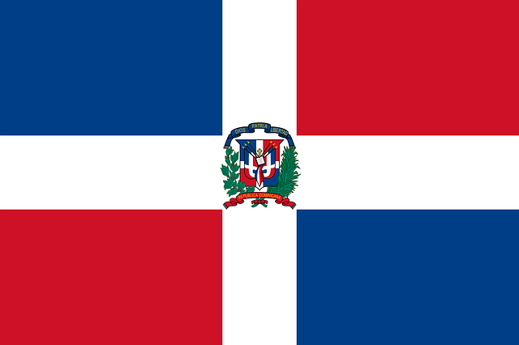
OSCAR DE LA RENTA
Name: Óscar Arístides de La Renta Fiallo
Country: Dominican Republic
Date of Birth: July 22, 1932
What does he do?: He is a fashion designer
He achieved international fame for being one of the clothing designers of First Lady Jacqueline Kennedy. He was in charge of designing the uniform for the Boy Scouts in 1978, donating his time to redesign the olive and brown uniform that is still in use today. Several famous celebrities wear his designs.
He is one of the most outstanding representatives of American fashion in the last decades, and he is the designer for the current uniform of the Boy Scouts of America.
Source: https://es.wikipedia.org/wiki/%C3%93scar_de_La_Renta and http://www.listindiario.com/entretenimiento/2014/10/20/342183/Biografia-Oscar-de-la-Renta

Slide 17
CÉSAR CHÁVEZ
Name: César Estrada Chávez
Country: United States
(Mexican Descent)
Date of Birth: March 31, 1927
What does he do?: He is a civil rights activist
He was the founder of the United Farm Workers Union that organizes immigrants, mostly Hispanic, to fight to improve their working conditions. He was a leader in restricting the immigration of illegal field workers and a protector for better wages and rights for the unionized American farm workers.
He contributed to the American labor movement in favor of Latinos.
Source: https://es.wikipedia.org/wiki/C%C3%A9sar_Ch%C3%A1vez and https://www.biografiasyvidas.com/biografia/c/chavez_cesar.htm

Slide 18
GLORIA ESTEFAN
Name: Gloria María Milagrosa Fajardo García
Country: Cuba
Date of Birth: September 1, 1957
What does she do?: She is a singer
She studied at a Catholic school in Miami where she learned how to play guitar. She’s a member of a band called Miami Sound Machine, created by Emilio Estefan Jr. She is one of the bestselling musical artists of all time and is considered the Mother of Latin pop music.
She took the risk of singing in Spanish, and the results were excellent. She has sold millions of albums worldwide, helping the United States surrender to the powerful growth of Latin culture. She has received the Presidential Medal of Freedom for her influential contributions to Latin music.
Source: https://www.buenamusica.com/gloria-estefan/biografia and https://es.wikipedia.org/wiki/Gloria_Estefan

Slide 19
ISABEL ALLENDE
Name: Isabel Allende Llona
Country: Chile
Date of Birth: August 2, 1942
What does she do?: She is a writer
She is the daughter of a Chilean diplomat who taught her love for the written word. She studied journalism. While writing plays and children's stories, she works as a writer and columnist for newspapers and television. Isabel Allende's first great novel was The House of Spirits.
She is one of the most outstanding, living writers of Hispanic-American literature.
Source: https://www.biografiasyvidas.com/biografia/a/allende_isabel.htm and https://es.wikipedia.org/wiki/Isabel_Allende

Slide 20
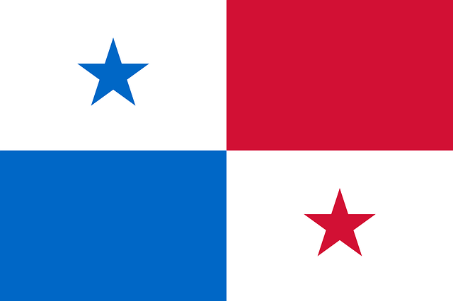
RUBÉN BLADES
Name: Rubén Blades Bellido de Luna
Country: Panama
Date of Birth: July 16, 1948
What does he do?: He is a singer
In addition to being a singer, Rubén Blades is a composer, a musician, an actor, a lawyer, and a politician. From the 70's until now, he has recorded more than 20 albums. He was also an actor in several diverse Hollywood and independent films. In recognition of his work, he received six Grammy Awards. In 1994, he was a presidential candidate in the Panama elections.
He is the perfect example of an artist who uses the arts as a means of expression. He’s a great representative of Latin music.
Source: https://es.wikipedia.org/wiki/Rub%C3%A9n_Blades and http://salsaclasica.com/rubenblades/bio.asp. Photo: https://commons.wikimedia.org/wiki/File:Ruben_Blades_by_Gage_Skidmore.jpg

Slide 21
JOSÉ FELICIANO
Name: José Monserrat Feliciano García
Country: Puerto Rico
Date of Birth: September 10, 1945
What does he do?: He is a singer and composer
He is blind from birth, and from a very young age he became interested in music. He stood out by singing boleros and ballads and playing the Spanish guitar. His song Feliz Navidad is one of the most listened to melodies in the world during the Christmas season. In 2013, he entered into the Latin Songwriters Hall of Fame.
He is considered the first Latin American to enter the English music market, opening the doors to other artists.
Source: https://es.wikipedia.org/wiki/Jos%C3%A9_Feliciano and https://www.buenamusica.com/jose-feliciano/biografia. Photo: https://commons.wikimedia.org/wiki/File:Jos%C3%A9_Feliciano.jpg

Slide 22
ÓSCAR DE LA HOYA
Name: Óscar de la Hoya
Country: United States
(Mexican descent)
Date of Birth: February 4, 1973
What does he do?: He is a boxer
He is the only American boxer to have won a gold medal at the Olympics, which is why he’s known as the Golden Boy. He then entered professional boxing and became a champion in six different divisions. He is one of the best boxers in history.
He is the only American boxer to have won a gold medal at the Olympics.
Source: https://es.wikipedia.org/wiki/%C3%93scar_de_la_Hoya and https://www.buscabiografias.com/biografia/verDetalle/6442/Oscar%20De%20La%20Hoya. Photo: https://commons.wikimedia.org/wiki/File:Oscar_De_La_Hoya,_Jul_2010.jpg

Slide 23
OSCAR HIJUELOS
Name: Oscar Jerome Hijuelos
Country: United States
(Cuban descent)
Date of Birth: August 24, 1951
What does he do?: He is a writer
He is the first Hispanic to have won the Pulitzer Prize for Fiction, for his novel “Mambo Kings Play Songs of Love.” This novel was later adapted for cinema.
He is the first Hispanic to win a Pulitzer Prize.
Source: https://www.buscabiografias.com/biografia/verDetalle/1492/Oscar%20Hijuelos and https://es.wikipedia.org/wiki/Oscar_Hijuelos

Slide 24
RAÚL JULIÁ
Name: Raúl Rafael Carlos Juliá y Arcelay
Country: Puerto Rico
Date of Birth: March 9, 1940
What does he do?: He is an actor
He worked in theater, film, and television. He played dramatic, comedy and musical roles. He achieved international fame in the 90s by playing Gomez in The Addams Family. He leaves behind more than 30 theatrical works, around 36 films, and the memory of his commitment for a better society through his involvement in The Hunger Project.
Received the National Council of La Raza Award for promoting a good image of Latinos.
Source: https://es.wikipedia.org/wiki/Ra%C3%BAl_Juli%C3%A1 and https://www.buscabiografias.com/biografia/verDetalle/2569/Raul%20Julia

Slide 25
RICKY MARTIN
Name: Enrique Martín Morales
Country: Puerto Rico
Date of Birth: December 24, 1971
What does he do?: He is a singer
He began his musical career in the mid-80s, as a vocalist for the boy band Menudo. In 1991, he launched his solo career. He also participated in the soap opera General Hospital and in the musical Les Misérables. He has sold more than 60 million albums and has received many awards.
He established the Ricky Martin Foundation in 2002, and created the People For Children project to combat child trafficking and sexual exploitation.
Source: https://es.wikipedia.org/wiki/Ricky_Martin and https://www.biografiasyvidas.com/biografia/m/martin_ricky.htm. Photo: https://commons.wikimedia.org/wiki/File:Ricky_Martin_in_store_appearance,_Sydney_Australia_(3).jpg

Slide 26
CARLOS NORIEGA
Name: Carlos Ismael Noriega Jiménez
Country: Peru
Date of Birth: October 8, 1959
What does he do?: He is an astronaut
After joining the US Marines, NASA selects him in 1994. On his first mission into space, he carried several symbols from his country: the flag and the drink “chicha morada.”
He helped set up the International Space Station.
Source: https://es.wikipedia.org/wiki/Carlos_Noriega and https://www.quien.net/carlos-noriega.php

Slide 27
EDWARD JAMES OLMOS
Name: Edward James Olmos
Country: United States
(Mexican descent)
Date of Birth: February 24, 1947
What does he do?: He is an actor and movie director
Known in the 1980s for playing Lieutenant Castillo in the Miami Vice series. He was nominated for an Oscar for Best Actor for playing Jaime Escalante, a Bolivian math teacher, in the film Stand and Deliver. He is the founder and director of Latino Public Broadcasting.
The Latino Public Broadcasting Foundation focuses on making public television programs that deal with the Hispanic-American community.
Source: https://es.wikipedia.org/wiki/Edward_James_Olmos and https://www.buscabiografias.com/biografia/verDetalle/2500/Edward%20James%20Olmos. Photo: https://commons.wikimedia.org/wiki/File:Edward_James_Olmos_Sept_06_crop_face.jpg

Slide 28
CHI-CHI RODRÍGUEZ
Name: Juan Antonio "Chi-Chi" Rodríguez
Country: Puerto Rico
Date of Birth: October 23, 1935
What does he do?: He is a golf player
He is the first Puerto Rican to enter the Golf Hall of Fame. As a child, he practiced improvised golf using a branch as a golf club and a metal can as a ball. At age 19, he joined the United States Army. He has won eight PGA Tour titles and 22 PGA Tour victories.
He helped to raise more than $4 million for his Youth Foundation in Clearwater, Florida, where he annually receives more than 600 children from poor families and broken homes to teach them about responsibilities and discipline at work.
Source: http://www.lexjuris.com/biografias/buscar/search.asp?rec_id=148 and https://en.wikipedia.org/wiki/Chi-Chi_Rodr%C3%ADguez

Slide 29
SONIA SOTOMAYOR
Name: Sonia Sotomayor
Country: United States
(Puerto Rican descent)
Date of Birth: June 25, 1954
What does she do?: She is a justice of the US Supreme Court
She obtained the position of Assistant District Attorney in New York. She participated in cases related to robberies, assaults, murders, police brutality, and child pornography. After years of experience, she established herself as a private lawyer in New York, and in 1991 became nominated for a position in the Southern District Court of New York. She became the youngest judge in that district as well as the first Hispanic federal judge in all New York.
On May 26, 2009, President Barack Obama nominated her to the position of Associate Justice of the Supreme Court.
Source: https://es.wikipedia.org/wiki/Sonia_Sotomayor#Nombramiento_en_la_Corte_Suprema_de_Justicia_de_los_Estados_Unidos
https://www.voanoticias.com/a/biografia-sotomayor-2009/81900.html

Slide 30
JUAN LUIS GUERRA
Name: Juan Luis Guerra Seijas
Country: Dominican Republic
Date of Birth: June 7, 1957
What does he do?: He is a singer
He is one of the most recognized international Latin artists from the past decade. His music is influenced by Dominican Caribbean rhythms, such as merengue and bachata. He has sold more than 30 million records and has won numerous awards.
He made bachata popular on a global level.
Source: https://www.buscabiografias.com/biografia/verDetalle/8808/Juan%20Luis%20Guerra and https://es.wikipedia.org/wiki/Juan_Luis_Guerra. Photo: https://commons.wikimedia.org/wiki/File:Juan_Luis_Guerra_AC.jpg

Slide 31
JUAN PABLO MONTOYA
Name: Juan Pablo Montoya Roldán
Country: Colombia
Date of Birth: September 20, 1975
What does he do?: He is a race car pilot
He participated in the World Cart Championship in the Junior category in Italy when he was 15 years old. He is also a member of the select group of Formula 1 drivers. He ended his Formula 1 career in 2006 to join NASCAR in the United States.
He is the only driver to win the CART series, the Indianapolis 500, and the Daytona 24 Hours, all on the first try.
Source: https://es.wikipedia.org/wiki/Juan_Pablo_Montoya and https://www.biografiasyvidas.com/biografia/m/montoya_juan_pablo.htm. Photo: https://commons.wikimedia.org/wiki/File:Juan_Pablo_Montoya.jpg

Slide 32
Página Web: www.speakinglatino.com
@SpeakingLatino
www.facebook.com/speakinglatino
www.pinterest.com/speakinglatino
www.youtube.com/user/SpeakingLatino
speakinglatino.tumblr.com
instagram.com/speakinglatino
jared@speakinglatino.com

